Slide 2
Write into the day 3 September 2018
Progress Reports are coming out on Thursday this week.
What have you done to actively achieve the goals you have for Junior year? What do you still need to do? What do you need help with?

Slide 3
Tentative Schedule
Tuesday, 3 September: Begin identifying vs analyzing Unit
Wednesday, 4 September: Discuss homework and Commercial Analysis work with partner
Thursday, 5 September: Discuss homework and Commercial Analysis work with partner
Friday, 6 September: Intro words for September Bootcamp and Commercial Analysis work with partner
Monday, 9 September: MCM
Tuesday, 10 September: Commercial presentations
Wednesday, 11 September: Commercial Presentation
Thursday, 12 September: Half Day and Log into AP Classroom
Friday, 13 September: Bootcamp Quiz

Slide 4
Essential Questions for all Analysis
What’s the writer’s purpose?
How does the writer use rhetorical strategies to achieve that purpose
WHY do the rhetorical strategies affect the writer's intended audience?
Write these questions in big, purposeful letters on your notes.

Slide 5
Strategies
Not necessarily metonymy or synecdoche, even though it's impressive if you know what these are.
Strategies = words and details
What words and details does the writer use to get the point across and why?
Identify the important words and details in the text, then explain the effect—that’s the analysis part.

Slide 6
Strategies and analysis: In sports
Let's watch the game!
Your job: focus on what they hear from the announcers
What two categories does their commentary fall under?

Slide 7
Strategies and Analysis: In Sports

Slide 8
Strategies and Analysis: In Sports
https://www.youtube.com/watch?v=1Xa67skNKoc
The Music City Miracle

Slide 9
Strategies and analysis: In sports
The Play-by-Play
The Color Commentary
Play-by-Play = identifying the moves/what's happening in the text
Color Commentary = analysis...Why are they doing it? What effect does it have on the purpose or the intended audience?

Slide 10
Strategies and Analysis: Commercials
Task: Watch the commercial and identify SOAPSTone
Speaker
Occasion
Audience
Purpose
Subject
Tone
Exigence

Slide 11
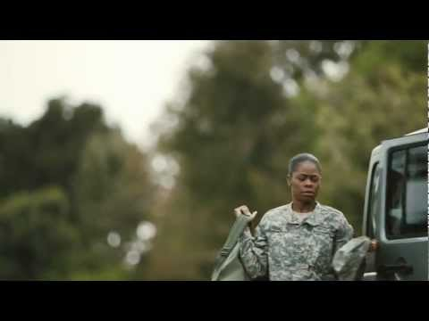
Strategies and Analysis: Commercials
https://www.youtube.com/watch?v=PQtjsZA4bTg

Slide 12
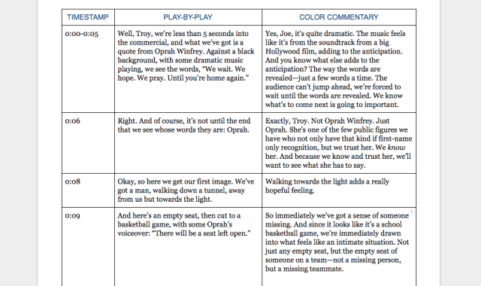

Slide 13
Homework
Read LOC Chapter 2
Pgs. 39-48
Do the activity for Ellison's essay. The activity is on pgs. 47-48.
Typed or hand written. Create questions different than the list provided for you on pg. 47.

