Slide 1
Text 2 Packet
This Photo by Unknown author is licensed under CC BY.
Name:
Class period:
Due MONDAY 11/4

Slide 2
You have selected your 2nd text in our unit: "Is America just?"
Answer the questions below about your text
In 21 words or more, what drew you to this text?
Rate your interest/passion level for this issue on a scale of 1-10 and explain why your chose that #
What is the author's main point/purpose in this text?
Why do you agree or disagree with their stance?
Based on first impressions, what did the author use to make their point strong?

Slide 3
Wednesday, OCT 30th
Read over your text and notice any STYLE devices (figurative language, hyperbole, mood/tone words, etc.) Why would the author use those in the text? What do they add? (please quote specific examples with paragraph numbers)
What is the author's point of view on this subject? How do you know? (please cite examples with paragraph numbers)
In this issue, who/what is hurting or experiencing injustice? Explain
Which do you think is the strongest paragraph for the author's argument? Why? (please cite specific examples with paragraph numbers)
What would you have added to make the appeal stronger? Give examples of how you would word it.
(continued on back)

Slide 4
Wednesday, OCT 30th
Paragraph response:
With a clear structure (Intro sentence, three obvious examples/points/evidences, and thesis statement/conclusion), please write a 5+ sentence paragraph responding to the following prompt.
How does this text fit into our Social Justice unit?
You can compare/contrast it to the first text ("Get a Knife, Get a Dog, but Get Rid of Guns" by Molly Ivins) , or explain how this issue violates justice.

Slide 5
Thursday, OCT 31st
Analyze your text for SOAPStone and other rhetorical devices
You may have to do a little research on the internet to recall what these devices look like and how to find them. Don't be afraid to help each other!
Speaker
Occasion
Audience
Purpose
Subject
Tone (with specific quote examples)
Ethos, Logos, OR Pathos (with specific quote examples)
Sum it up in a sentence!! Why is the author writing this sentence and what do they use to make their point? (For example: The author wants the reader to vote for Kanye 2020, and she uses a lot of logos/logic to make the reader assume he's the right candidate.)

Slide 6
Thursday, OCT 31st
Research these rhetorical techniques and choose ONE to find in your text (use specific quote example).
Bandwagon, repetition, parallelism, kairos appeal, personification, pleonasm, rhetorical question, or zeugma/syllepsis.
Paragraph response:
With a clear structure (Intro sentence, three obvious examples/points/evidences, and thesis statement/conclusion), please write a 5+ sentence paragraph responding to the following prompt.
Is this author's use of rhetoric effective?
Is their argument good? Do they prove their point? What makes their argument strong? OR, why is it a weak argument? What could they have done better?

Slide 7
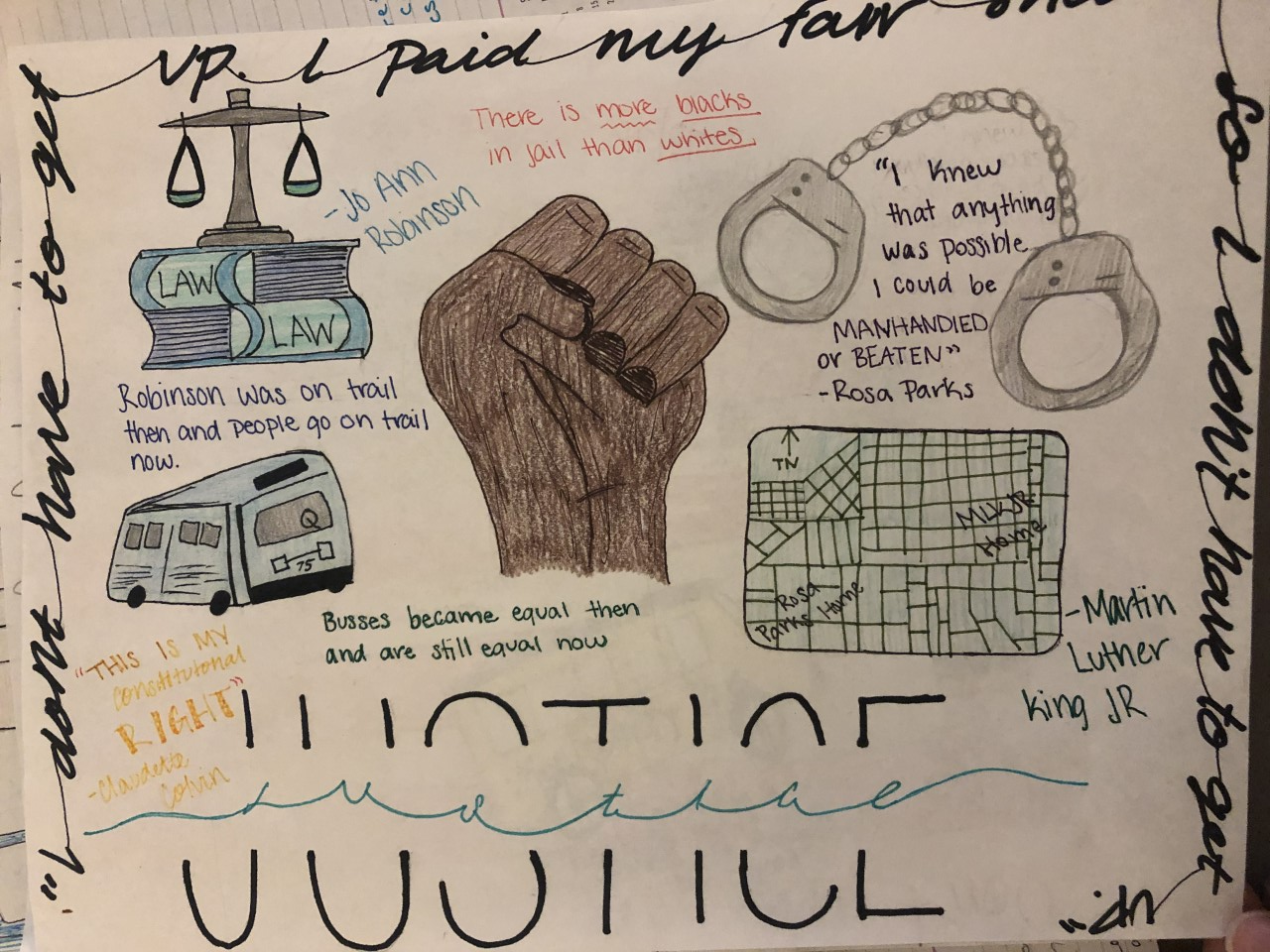
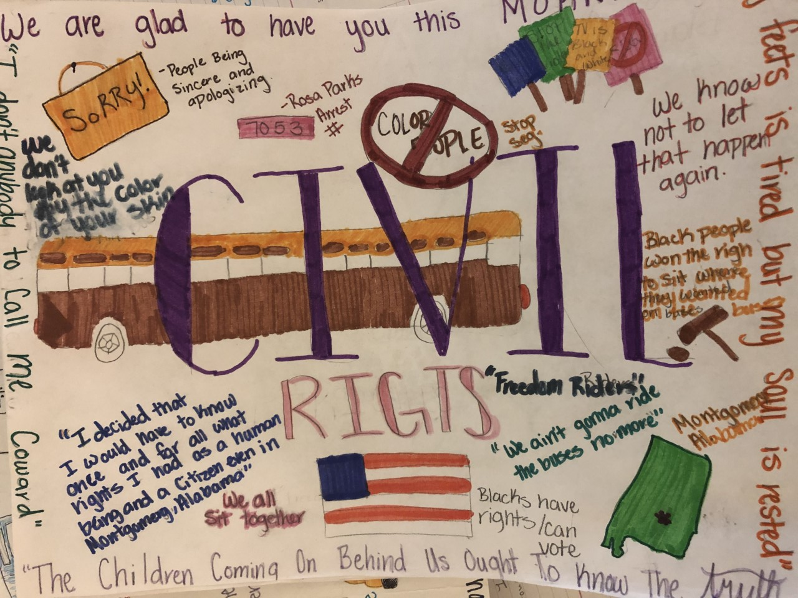
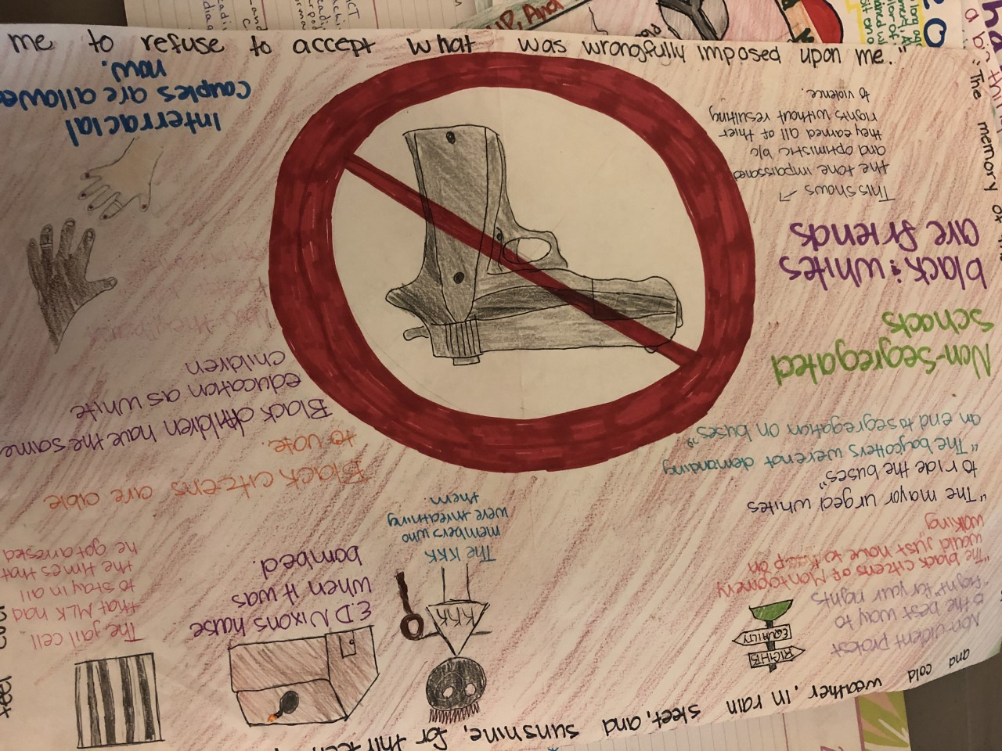
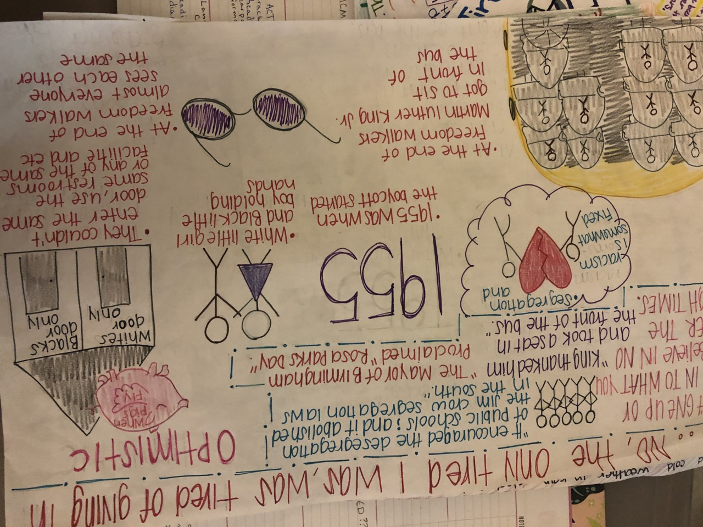
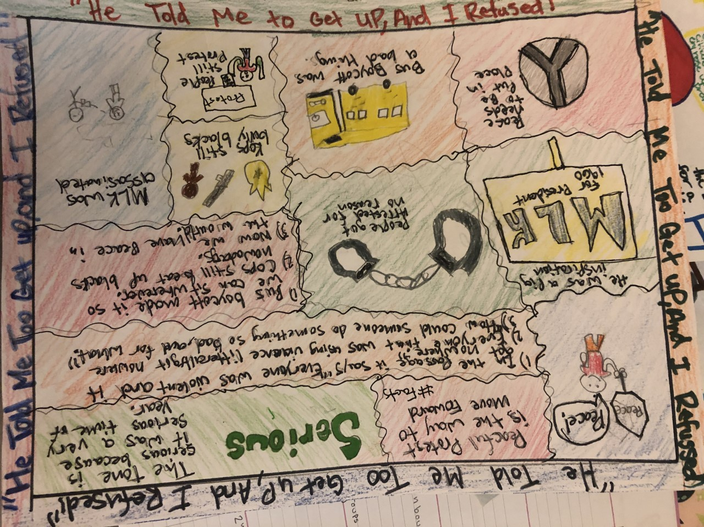
Friday, Nov 1st
On the back of this page, complete a "ONE-PAGER," or, a single page summary of your chosen text.
You may either:
1. Write a single page summary and analysis.
Summarize the main points
Was this good rhetoric?
What were the author's strengths and weaknesses?
How does this text fit into the Essential Question "Is America just?"
OR
2. Create a visual one-pager
Examples of ONE-PAGER visuals ->
The writing choice (#1) should be completed on the back of this page. Option #2 goes on the next page behind the rubric.
Social Justice in America – Choice Article One-Pager
What is a One-Pager? A One-Pager is a response to a reading. Using a white piece of paper, you will give details about the social justice article you chose and current events using quotes and visuals. The final result must look clean and colorful. You can layout your information and visuals in any way you want, but it must have all the components listed below.

Slide 8
Friday, Nov 1st
If you chose to write a one-page summary based on the requirements on the previous page, write it below:

Slide 9
Required Components | Expectations | Student Checklist (check off as completed) | Points Earned (grader only)
Border | This should be your favorite, or the most significant, quote from the article. Should take up all 4 borders. May repeat if necessary. |  | ___ / 5
Speaker | Provide the name/author/organization of the article |  | ___ / 3
Speaker Visual | Provide ONE visual to represent the speaker. It should be neat, and colored. It could be an actual drawing of the person. Another example: If it is a scientific group, draw something to represent that organization. (You may have to do a little research.) |  | ___ / 5
Occasion | Write the time and the place from when the article was written. (You may have to do a little research.) |  | ___ / 3
Audience | Write down who the audience is. Also include an explanation and/or evidence from the article for why you think they are the intended audience. |  | ___ / 5
Audience Visual | Draw a visual representation or symbol that describes the audience. It should be neat and colored. |  | ___ / 3
Purpose (theme) | Write the purpose of the text. Think about what the audience or you- the reader- might think or do as a result of reading the text. |  | ___ / 5
Subject | Write the general topic/content/ideas contained in the text. Use 2 pieces of evidence from the article that supports this. |  | ___ / 5
Subject Visual | Draw one visual representation of the topic. It should be neat and colored. |  | ___ / 3
Tone | Include at least one visual representation for the overall tone of the novel. Provide an explanation for the tone. (Examples you may choose from: serious, critical, earnest, objective, impassioned, optimistic, righteous, sincere, solemn, or zealous) |  | ___ / 5
Resolution | Provide ONE visual to represent a possible resolution/answer/solution to the issue discussed in the article. It should be neat, and colored. Also provide an explanation for the visual. |  | ___ / 5
Personal Response or Connection | Make one personal connection between the text and the world using a sketch/drawing/visual representation. Also provide an explanation for the visual representing a personal response or connection. |  | ___ /5
Presentation | Your name should be on the back of the page in pencil. The result should look clean and colorful. This should be on 1 side of a blank, white piece of paper. (not notebook paper) |  | ___ / 8 Total:___/60

